Slide 1

WAY TO ENTERPRISE
Spring Framework

Slide 2
Agenda
Relationship Table
Foreign key
Copyright © VTI Academy All Rights Reserved

Slide 3
Relationship Table
3 types
  1-1
  1-n
  n-n

Slide 4
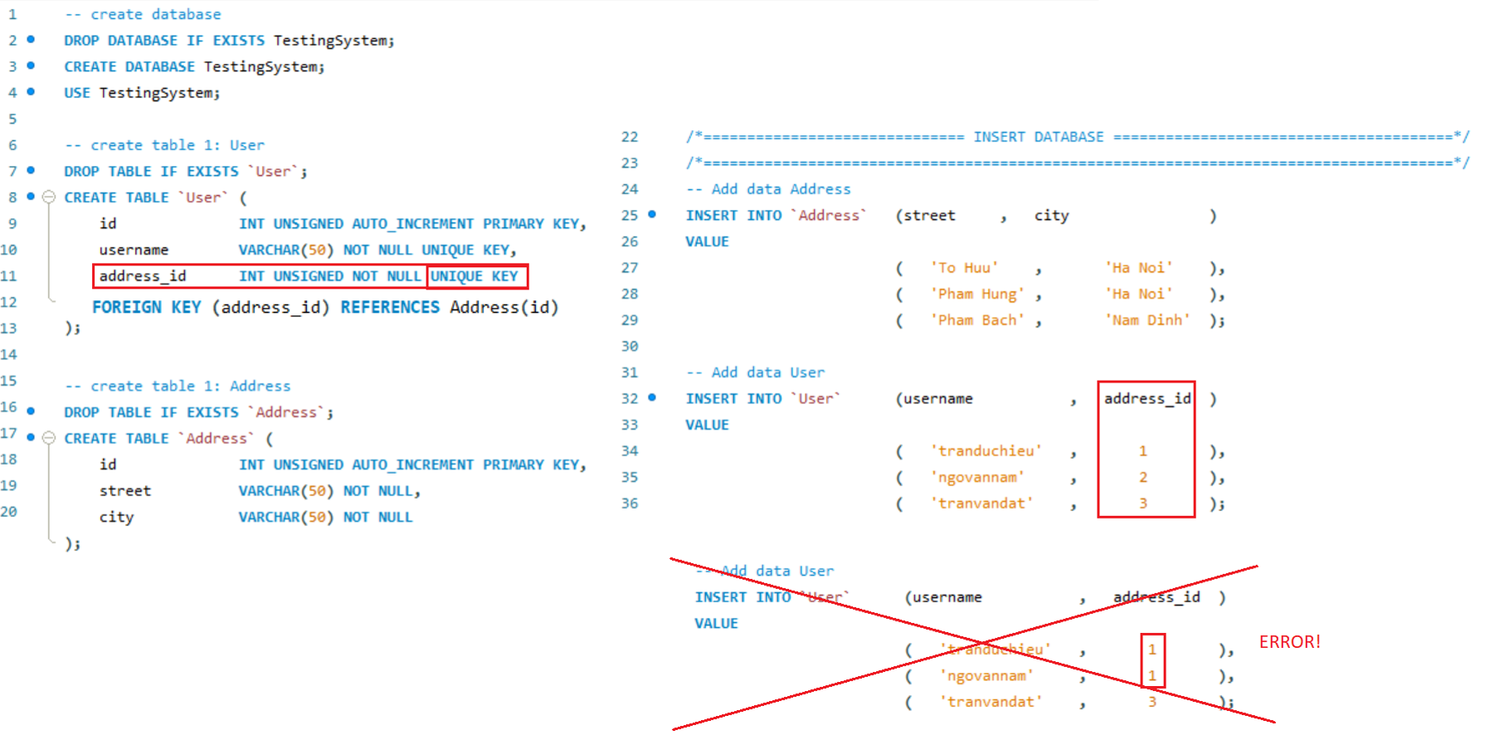
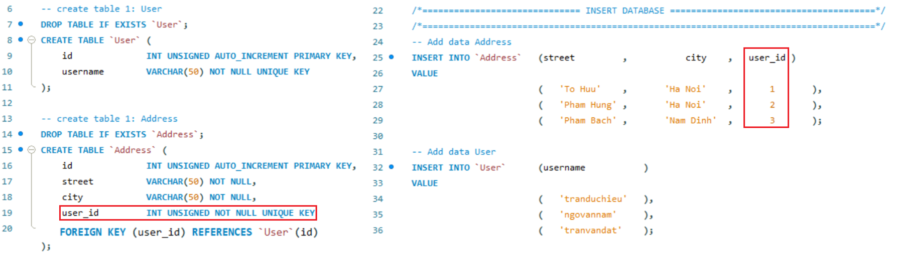
Relationship Table
1-1
Way 1
Way 2

Slide 5
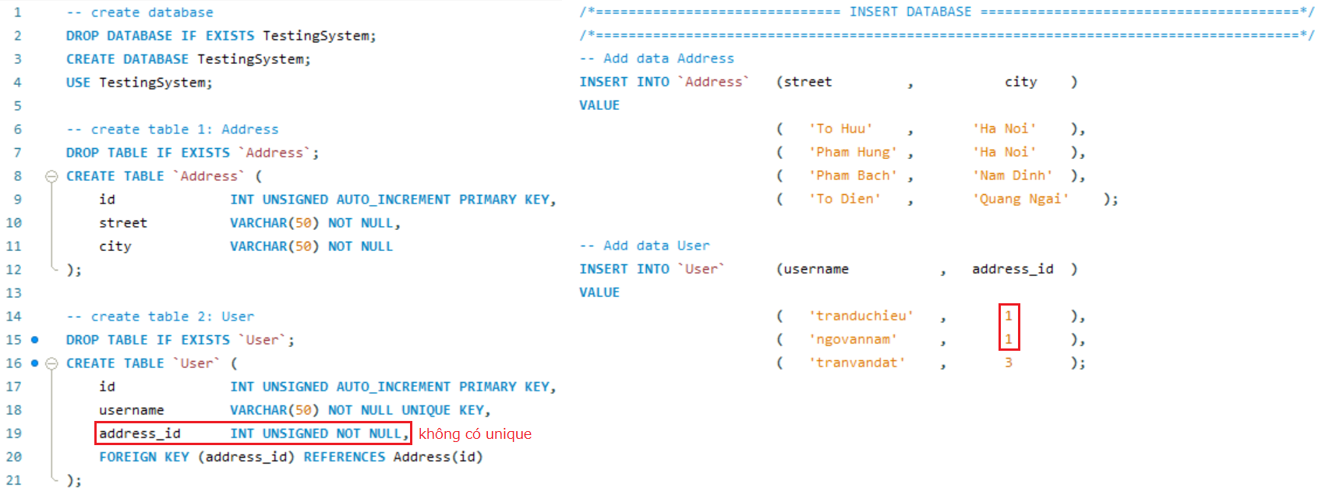
Relationship Table
1-n (n-1)
(Address) 1 - n (User)

Slide 6
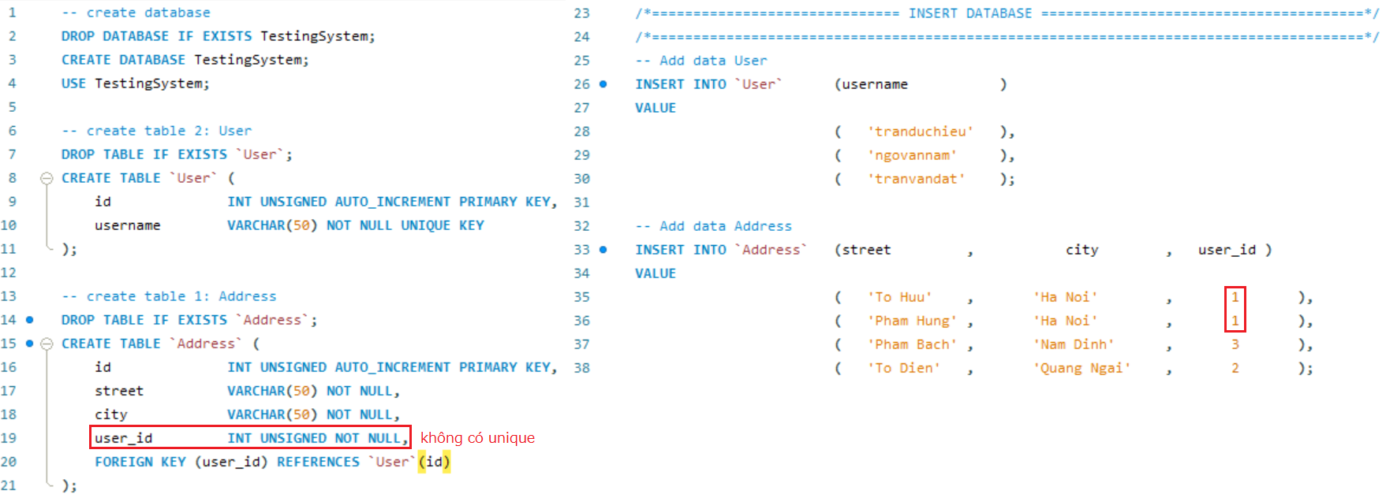
Relationship Table
(Address) n - 1 (User)

Slide 7
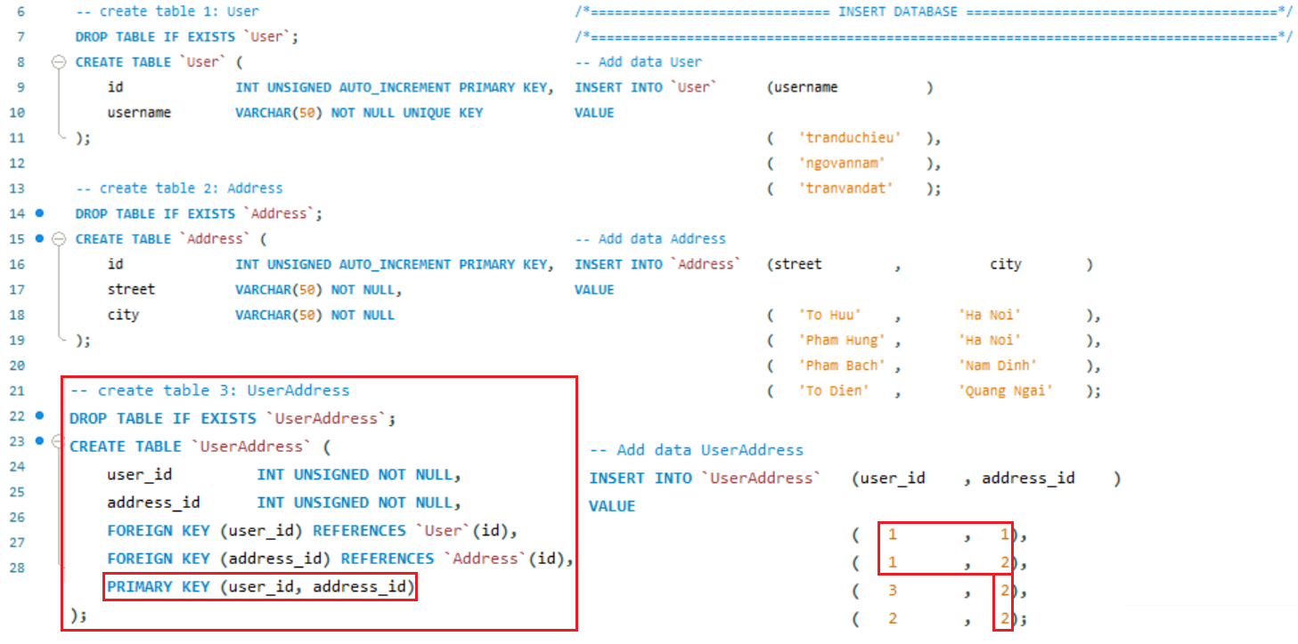
Relationship Table
n-n
(Address) 1 - n (User) & (User) 1 - n (Address)

Slide 8
Foreign key
3 types
  @OneToOne
  @OneToMany
  @ManyToMany

Slide 9
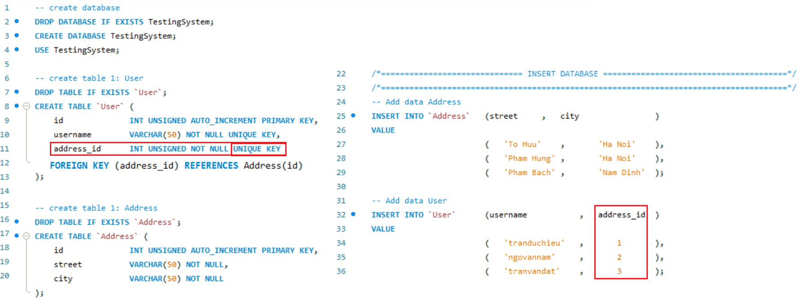
Foreign key
@OneToOne
Example 1:

Slide 10
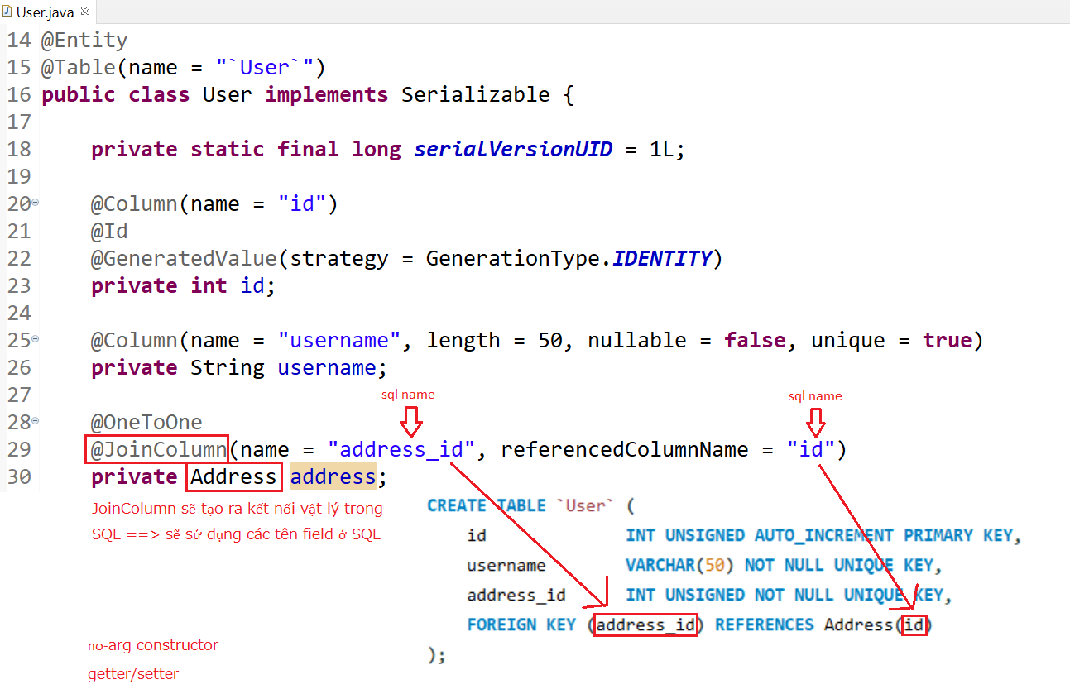
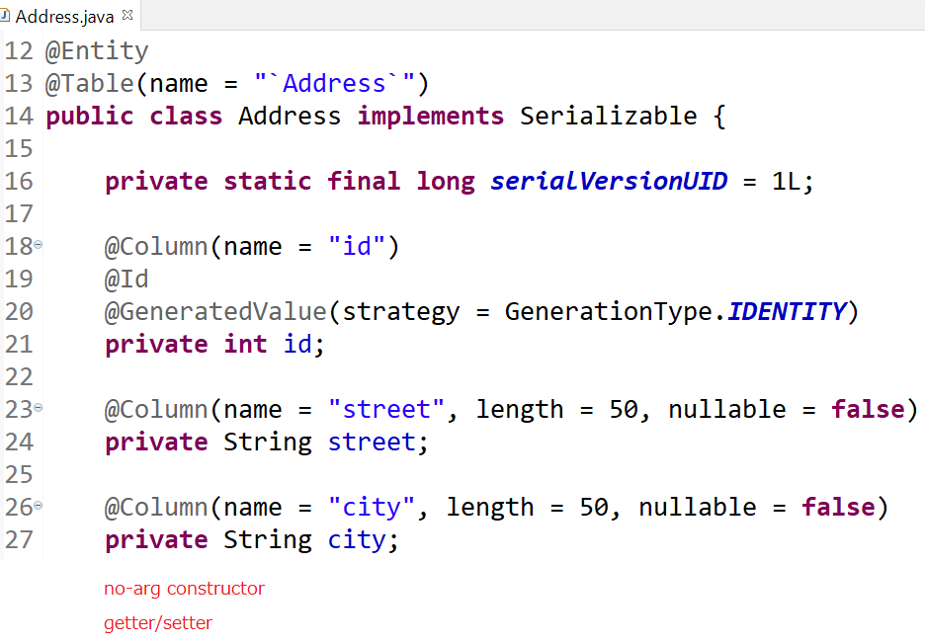
Foreign key
Entity

Slide 11
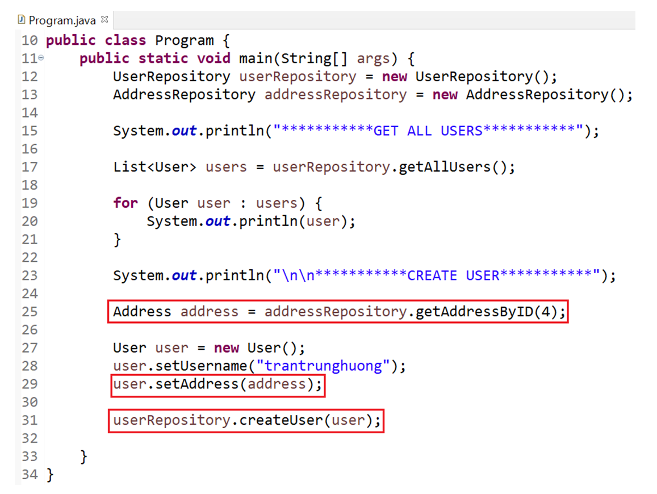
Foreign key
Select

Slide 12
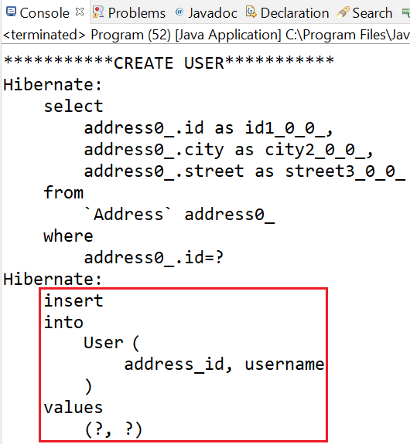
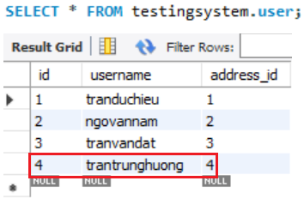
Foreign key
Create

Slide 13
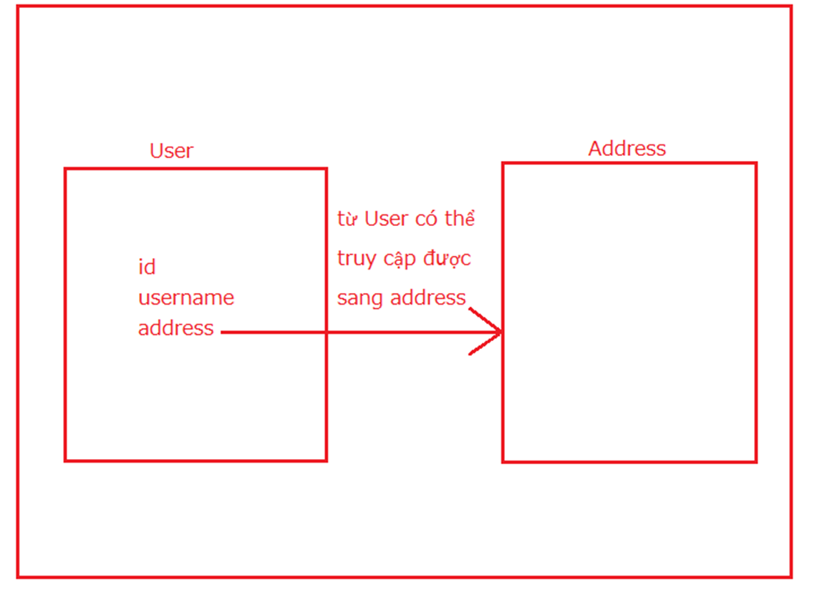
Foreign key
Summary

Slide 14
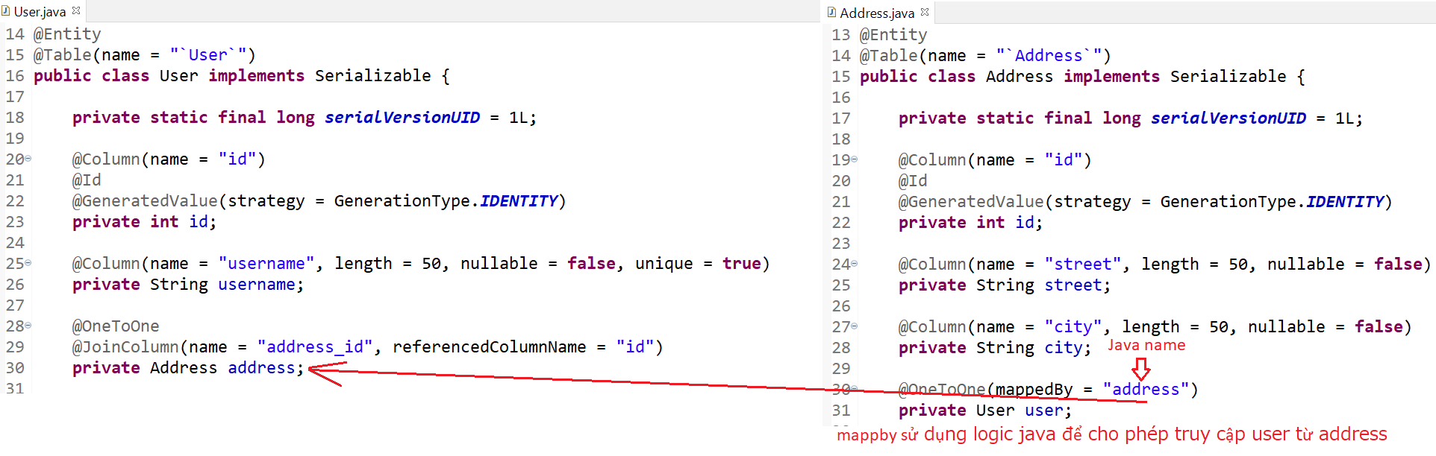
Foreign key
Example 2:

Slide 15
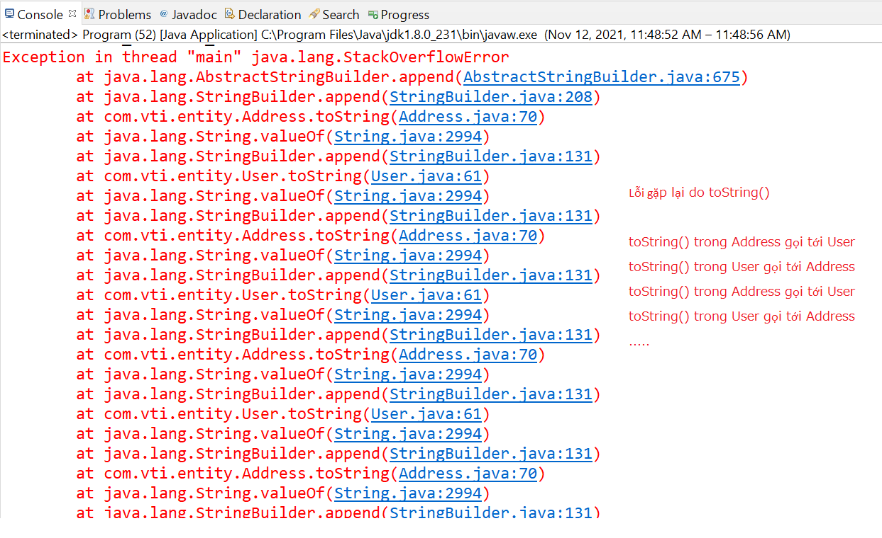
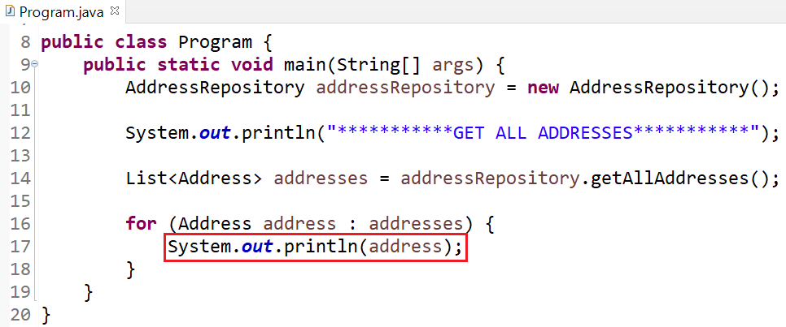
Foreign key

Slide 16
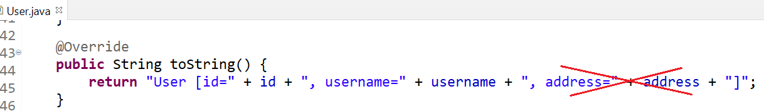
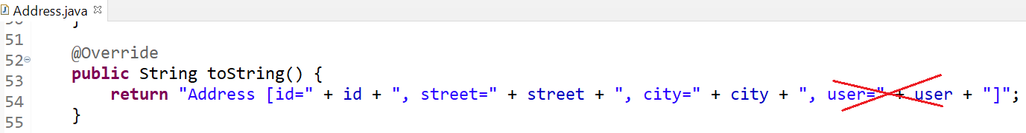
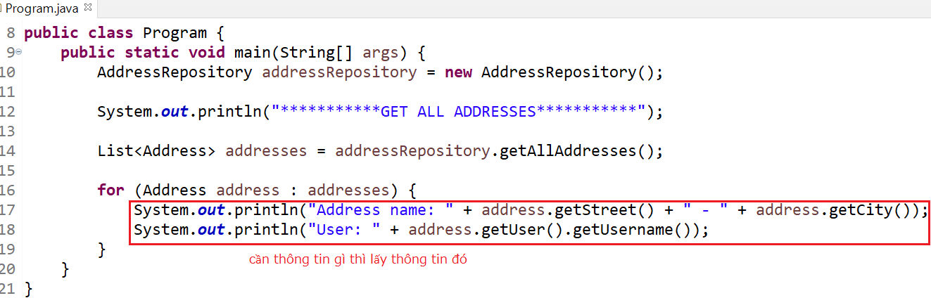
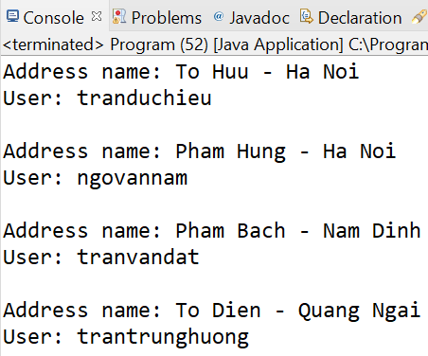
Foreign key
Fix
Edit toString()

Slide 17
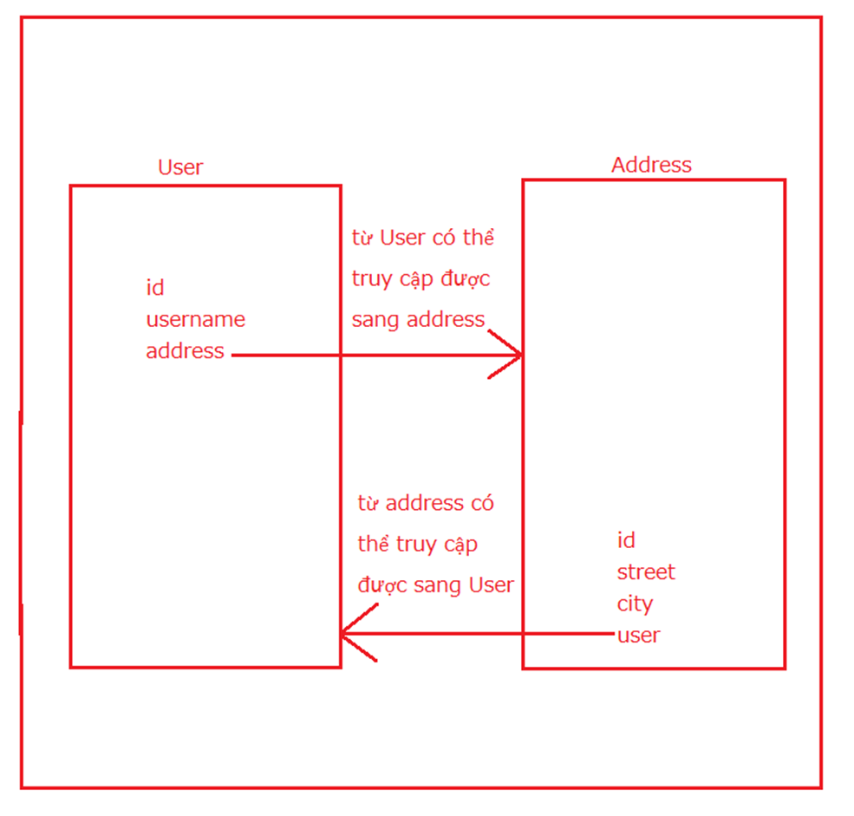
Foreign key
Summary

Slide 18
Foreign key
@OneToMany
(Address) n - 1 (User)

Slide 19
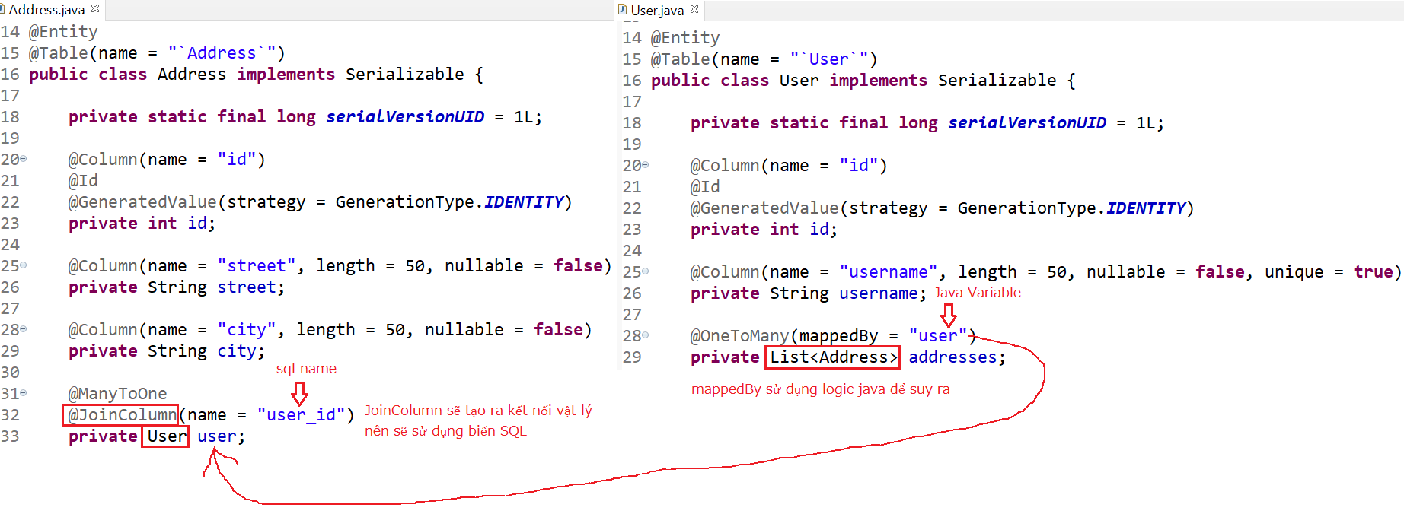
Foreign key
Entity

Slide 20
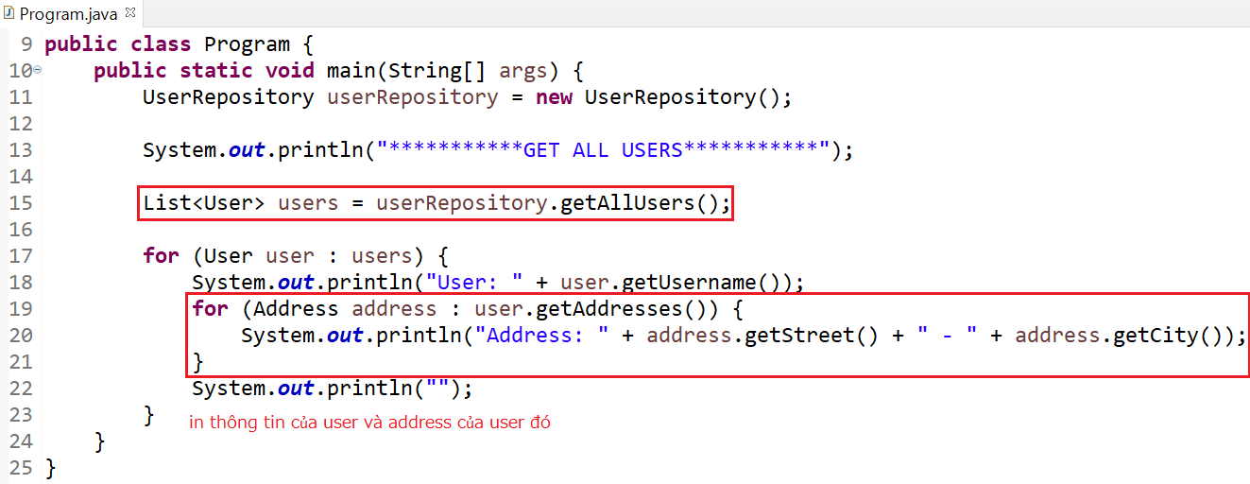
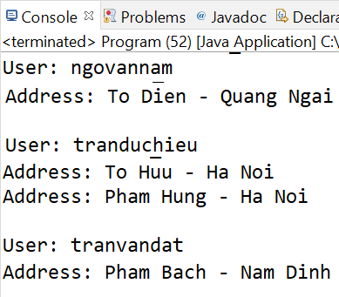
Foreign key

Slide 21
Foreign key
@ManyToMany
3 Types
  Basic
  Using a Composite Key
  New Entity

Slide 22
Foreign key
Basic

Slide 23
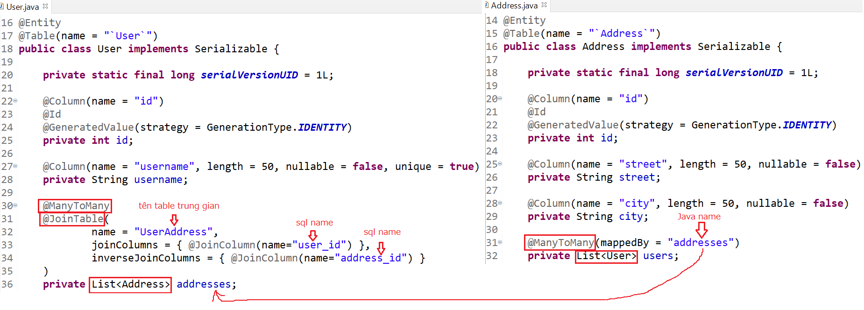
Foreign key
Entity

Slide 24
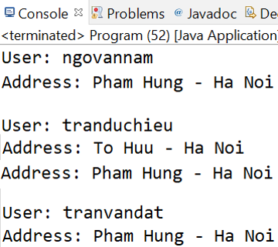
Foreign key

Slide 25
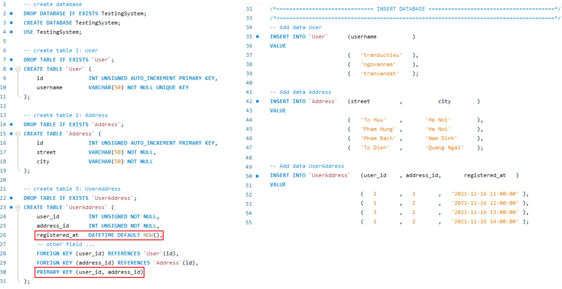
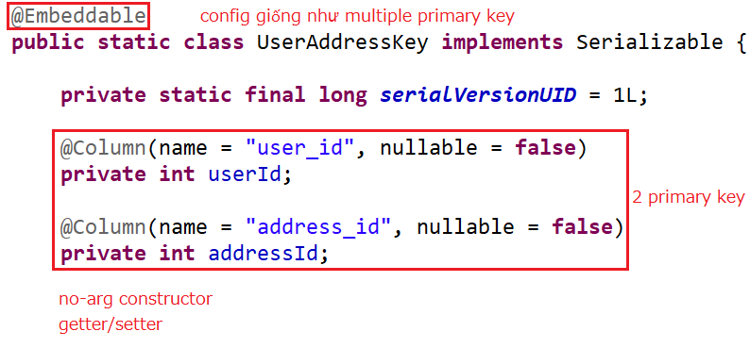
Foreign key
Using a Composite Key
Composite key

Slide 26
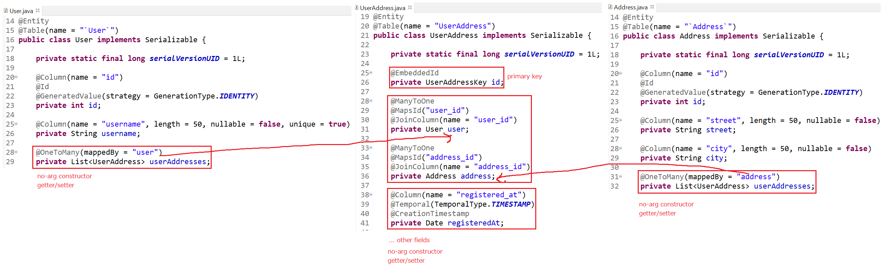
Foreign key
Entity

Slide 27
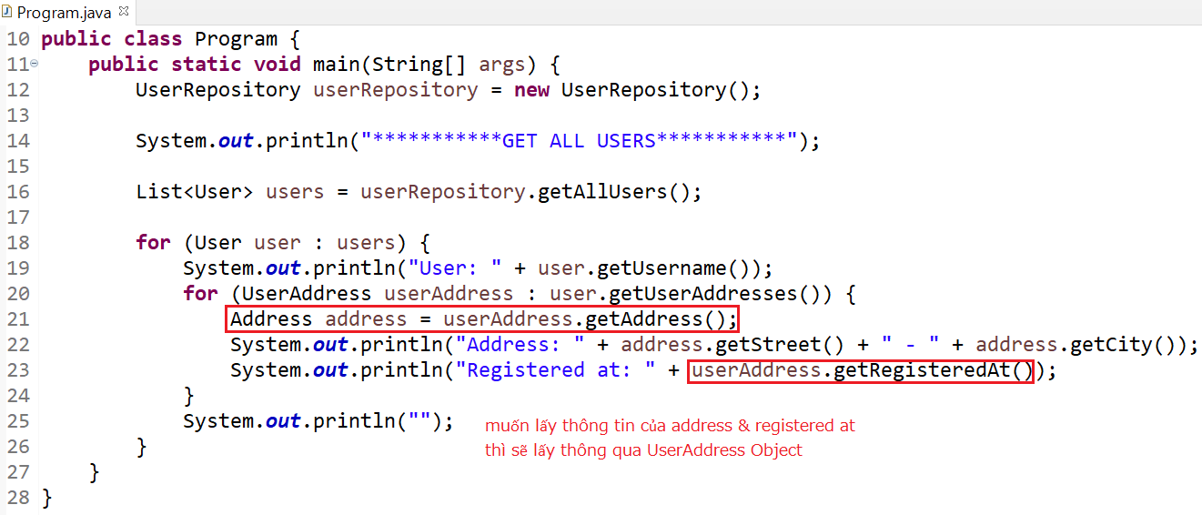
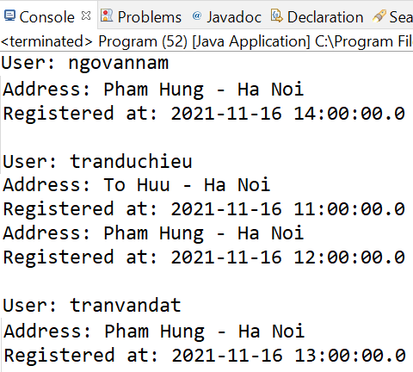
Foreign key

Slide 28
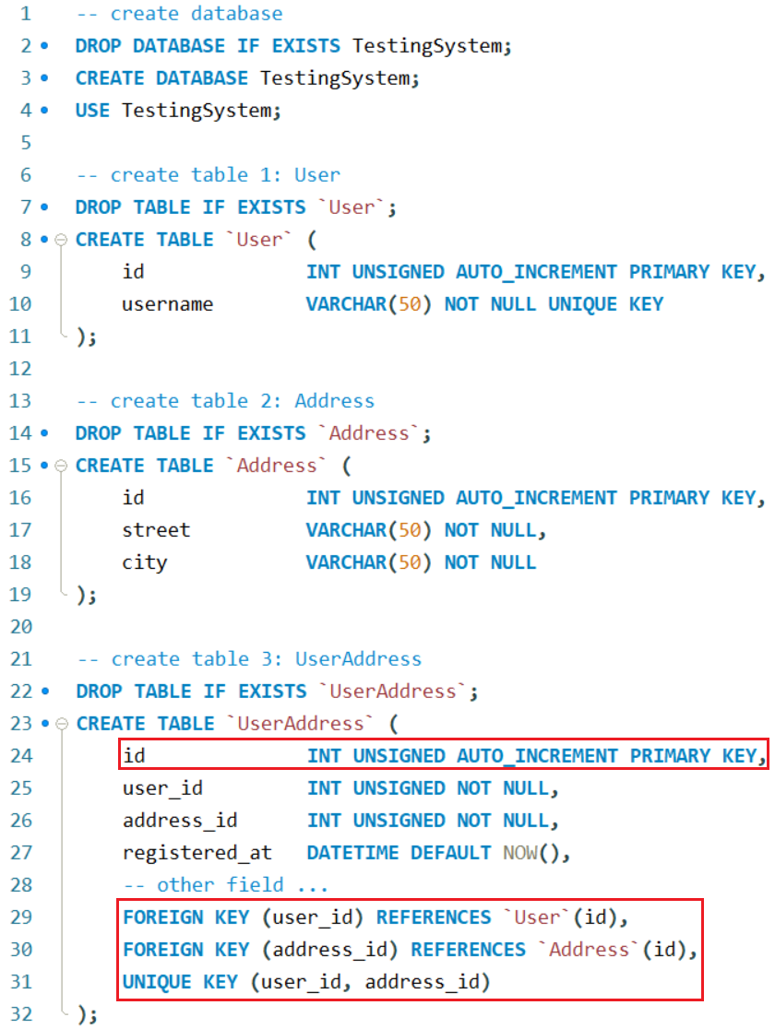
Foreign key
New Entity

Slide 29
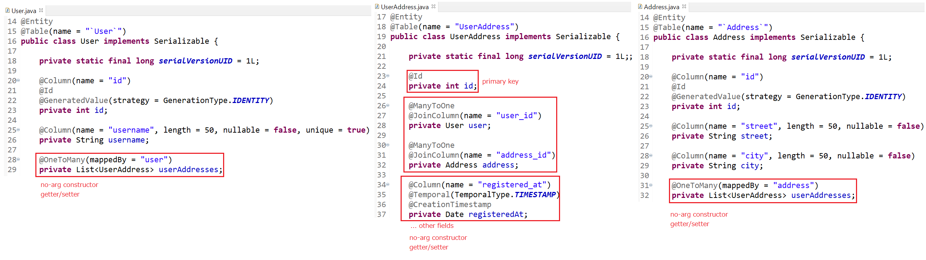
Foreign key
Entity

Slide 30
Foreign key

Slide 31
Summary
@OneToOne
@OneToMany
@ManyToMany
@JoinColumn & mappedBy

Slide 32
Q & A
Copyright © VTI Academy All Rights Reserved

